Slide 1
Teaching Systems Software with FreeBSD and Tracing
George V. Neville-Neil
Robert N. M. Watson

Slide 2
Motivations
Promulgate the understanding of large and complex systems
Bring modern tools to a wide variety of audiences
Advance the practice of software and systems engineering
Promote FreeBSD as a platform for teaching, research and development

Slide 3
Audiences
Masters Students in Computer Science
May not have an undergrad CS degree
Focus is on research skills
Undergraduates in Computer Science
Highest variability in background
May not know C
Practitioners
Experience with some programming language
Work experience

Slide 4
Operating-system teaching styles
Trial by fire (undergraduate): in micro, recreate classical elements and forms of OS design: kernels, processes, filesystems
Research readings course (graduate): read, present, discuss, and write about classic research; term project/exams
Deep-dive experimentation course (graduate): learn about and analyse {CPU, OS, protocol} behaviours using tracing on real-world systems
Possible due to recent development of integrated tracing and profiling tools: DTrace, CPU counters, etc.

Slide 5
What is DTrace? Why do we use it?
What
Why
A dynamic tracing framework for software
Low impact on overall system performance
Does not incur costs when not in use
Engineered for Safety
Originally developed on Solaris
Now on: Illumos, FreeBSD, and Mac OS
Total system transparency
Low risk of crashing the kernel
Used in production systems
D Scripting Language
DTrace One Liners

Slide 6
A Very Brief Example
# dtrace -n syscall:::dtrace: description 'syscall:::' matched 2148 probes
CPU ID FUNCTION:NAME
1 51079 ioctl:return
1 51078 ioctl:entry
1 51079 ioctl:return
1 51078 ioctl:entry
1 51079 ioctl:return
1 51632 sigprocmask:entry
1 51633 sigprocmask:return
1 51784 sigaction:entry

Slide 7
Masters Course design

Slide 8
Aims of the course
Teach methodology, skills, and knowledge required to understand and perform research on contemporary operating systems by...
Teaching systems methodology and practice
Exploring real-world operating-system artefacts in a structured laboratory setting
Developing scientific writing and presentation skills
Reading selected original systems research papers

Slide 9
In the classroom
6⨉ One-hour lectures
Theory, architecture, methodology, practice
5⨉ Two-hour practical laboratories
30-minute lecturelets on artefacts, tools, and practical techniques required to complete labs
Remainder as hands-on measurement and experimentation
Exploratory questions vs. experimental goals

Slide 10
Outside the classroom
Assigned readings
Selected portions of module texts
Specific contemporary and historic research papers
Assessed laboratory reports
Based on experiments done in (and out of) labs
Develop investigative skills
Learn about data analysis and presentation
Refine scientific writing style
One ‘practice run’ – marked but not assessed
Two assessed; 50% of final mark each

Slide 11
Core texts
Performance analysis
Raj Jain, The Art of Computer Systems Performance Analysis: Techniques for Experimental Design, Measurement, Simulation, and Modeling, Wiley - Interscience, New York, NY, USA, April 1991.
Tracing and profiling
Brendan Gregg and Jim Mauro, DTrace: Dynamic Tracing in Oracle Solaris, Mac OS X and FreeBSD, Prentice Hall Press, Upper Saddle River, NJ, USA, April 2011.
Operating systems
Marshall Kirk McKusick, George V. Neville-Neil, and Robert N. M. Watson, The Design and Implementation of the FreeBSD Operating System, 2nd Edition, Pearson Education, Boston, MA, USA, September 2014.

Slide 12
Masters Syllabus

Slide 13
Module 1: Introduction to kernels and tracing
Two lectures (re)-introducing operating systems
Lab 1: Getting Started with Kernel Tracing - I/O
Lab Report 1: I/O Performance

Slide 14
Lecture 1: Advanced operating systems
About the course
What is an operating system?
Generalization vs. specialization in OS design

Slide 15
Lecture 2: Kernels and tracing
How does kernel tracing work?
What is the probe effect?
How does kernel code run?

Slide 16
Module 2: The process model
Two lectures on the process model
Lab 2: Kernel implications of IPC
Lab 3: Micro-architectural implications of IPC
Lab Report 2: IPC Performance

Slide 17
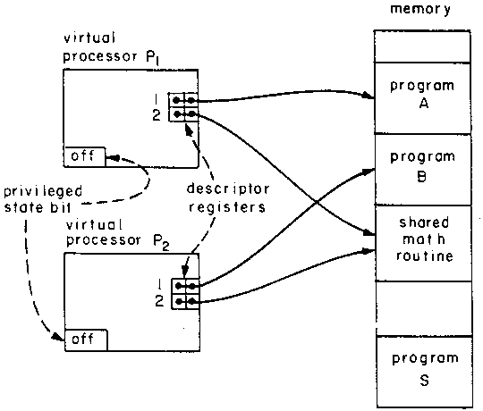
Lecture 3: The process model (1)
From Multics to UNIX: evolution of the process model
How programs run: ELF, run-time linking
Architectural and virtual-memory foundations
Traps and system calls

Slide 18
Lecture 4: The process model (2)
System-call mechanism and design
Security and reliability
Analysing system-call and trap performance using DTrace
Mach’s virtual-memory design

Slide 19
Module 3: TCP/IP
Lectures 5-6: The network stack
Lab 4: The TCP State Machine
Lab 5: TCP Latency and Bandwidth
Lab Report 3: The TCP State Machine, Latency, and Bandwidth

Slide 20
Lecture 5: The network stack (1)
Networking, the sockets API, and network-stack design
Memory flow across hardware and software
Kernel data structures for networking
Network-stack dispatch paths
Recent network-stack research

Slide 21
Lecture 6: The network stack (2)
TCP protocol design: state machine + congestion control
Feature evolution in network stacks
Key data structures and code paths
Network-stack performance across hardware and software

Slide 22
Masters Course Laboratories

Slide 23
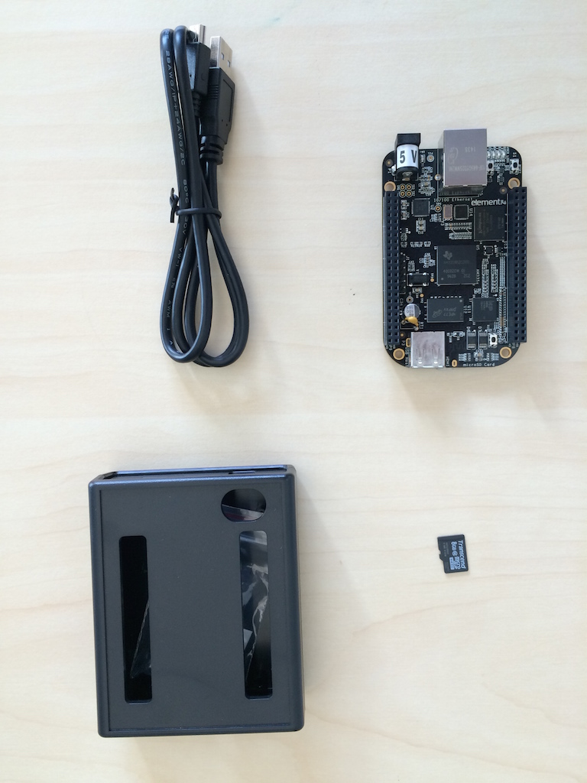
The Masters laboratory platform
BeagleBone Black
1GHz 32-bit ARM Cortex A-8
Superscalar, MMU; L1/L2 caches
Power, serial, network via USB
Deterministic performance for teaching -- unlike a virtual machine
SD card software image
FreeBSD operating system
DTrace
DUMMYNET simulation module
HWPMC framework
Custom microbenchmarks
POSIX I/O, POSIX IPC, TCP
Jupyter notebooks-based UI
Experiment execution and instrumentation
Data collection, analysis, presentation

Slide 24
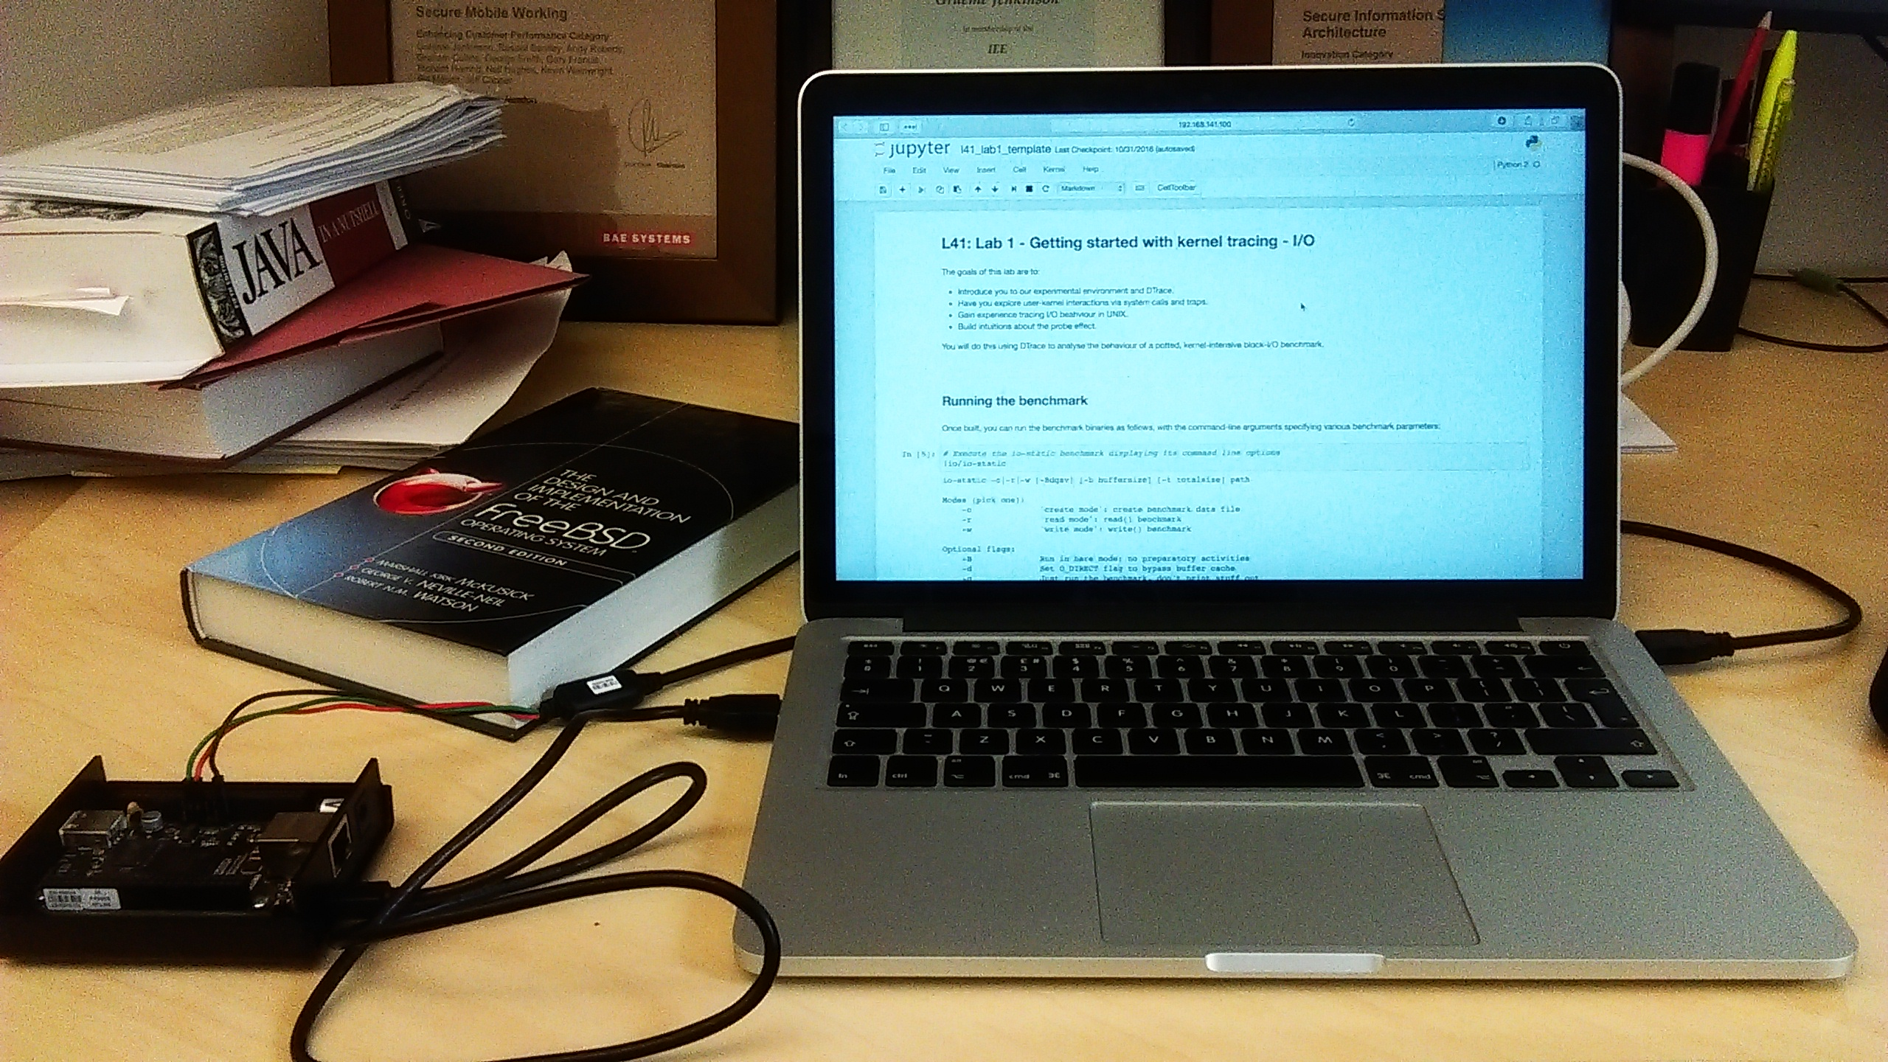
Jupyter notebooks (1)

Slide 25
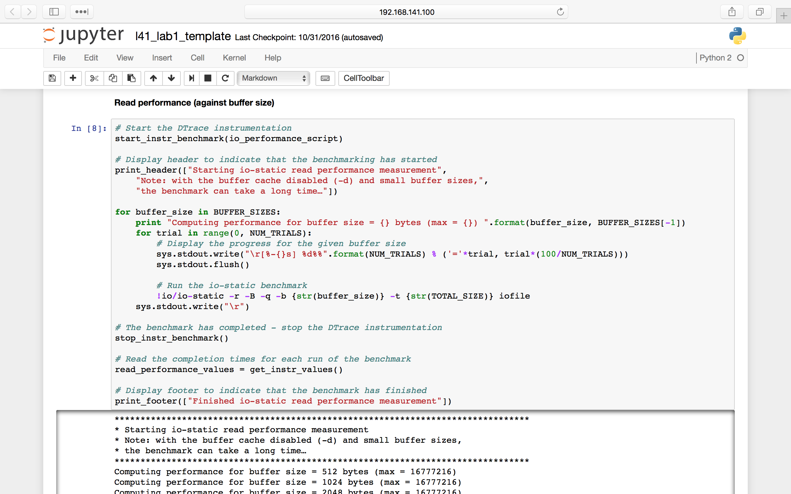
Jupyter notebooks (2)

Slide 26
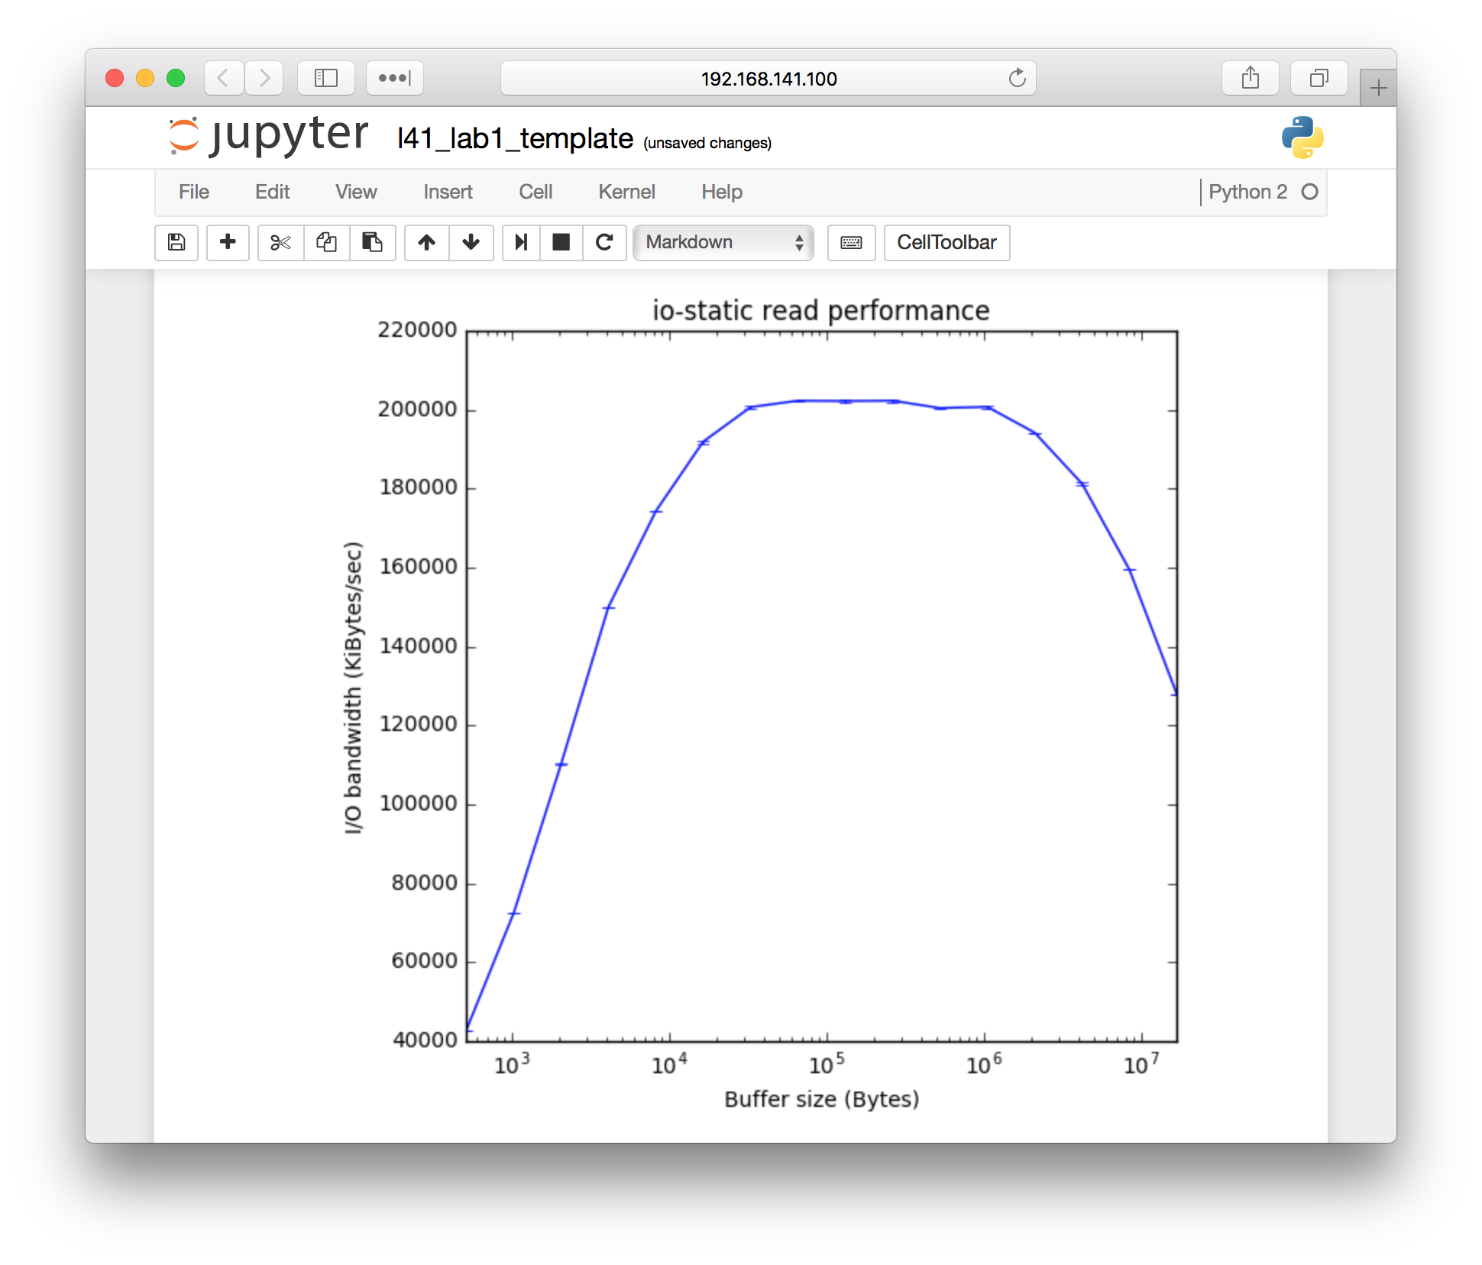
Jupyter notebooks (3)

Slide 27
Laboratory 1: POSIX I/O performance
I/O microbenchmark: constant total size, variable buffer size
Conventional view: fewer system calls, larger buffers will perform better
Process-model view: caches, VM system affect throughput; performance flat-line (then collapse) when thresholds exceeded

Slide 28
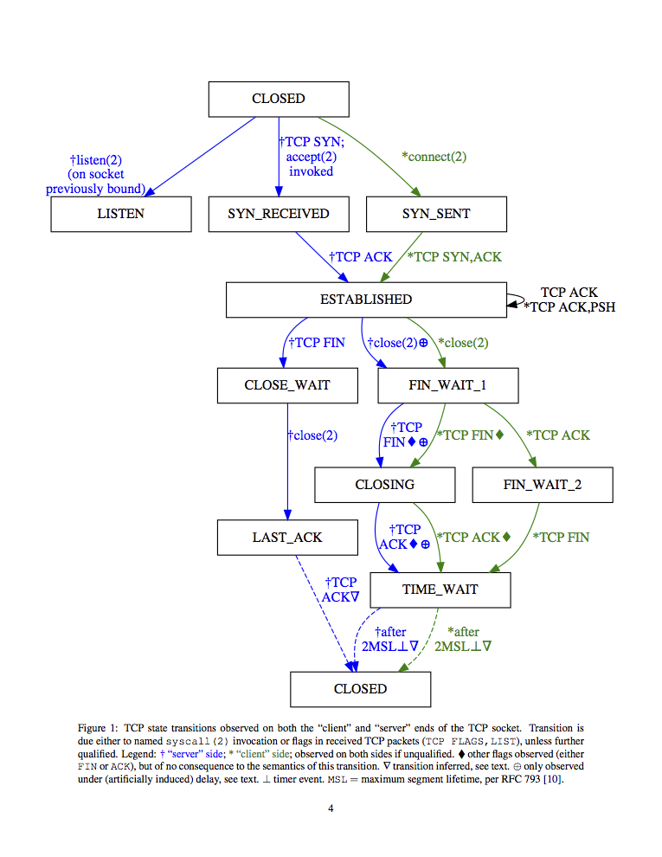
Laboratory reports
Validate and explore implied hypotheses
Scientific lab reports describe experiments
Focuses on:
Writing, presentation
Good scientific procedure – e.g., experimental setup
Consideration of sources of variance and error, probe effect
Correct conclusions drawn
Explanation of results

Slide 29
Work to date – and where next?
2014-2015 – first teaching
FreeBSD ARMv7 support for DTrace, CPU counters
Device-driver engineering for FreeBSD on BBB
Material developed, course introduced at Cambridge
2015-2016 – second teaching
FreeBSD improvements upstreamed
Material refined, open sourced via TeachBSD.org
Talks at several universities on the L41 approach
2016-2017 – third teaching
New iPython/Jupyter-based lab environment
Upstreaming of further FreeBSD improvements
Open-source release scheduled for February 2017

Slide 30
Undergraduate Course

Slide 31
Teaching Undergraduates
Requires a far more background material
Need to focus on the why as well as the what
Pacing is key to understanding
Repetition is required
Get them to understand how a whole system works
By showing them how a large piece of systems software works

Slide 32
Deeper Background
Mutual Exclusion
Locking
Deadlocks
Virtual Memory
Address Translation
Page Tables
TLBs
File System Principles
Block Storage
Naming
Caching
Networking Principles
Loss
Asynchrony
Addressing

Slide 33
Questions we expect them to answer
Name three pieces of software found in the kernel
Name three pieces of software found in user space
What states does a process go during the process life cycle?
Draw a diagram of two threads that are deadlocked.
Write a DTrace one-liner that captures sockets entering the fin-wait-1 state
Why does the name cache store negative entries?
What happens when you load a web page?

Slide 34
sh
fork()
exec()
master
socket()
bind()
listen()
read()
write()
close()
open()
read()
close()
write()
read()
sh
fork()
exec()
chrome
close()
wait()
exit()
socket()
connect()

Slide 35
Practitioners Course

Slide 36
Teaching Practitioners
We can assume more background:
Some knowledge of programming
Experience with Unix
Have real problems to solve
But not assume everything:
Kernel Internals
Deep understanding of corner cases

Slide 37
Goals of the Practitioner Course
Familiarize people withDTrace
Give them practical tools for their problems
Educate them about how the OS works
Dispel fear

Slide 38
The Practitioner’s Course Overview
Two, 8 hour days
Platform is a pre-packaged Virtual Machine image
Or a native FreeBSD system
Taught at conferences and companies
AsiaBSDCon 2016,
BSDCan 2015, 2016,
EuroBSD 2016 in Belgrade
Next course at AsiaBSDCon 2017 in Tokyo

Slide 39
Pracitioner’s Course Outline
Intro to DTrace
Locking
Scheduler
Networking
Files and the Filesystem

Slide 40
A Set of Worked Examples
Find and count all the available tracepoints
Summarize requested write() sizes by program name
Summarize return values from write() by program name
Adding new probe points to the system
Track succeeding and failing TCP connections
Look at name cache performance

Slide 41
Thank You
Ruslan Bukin
Mark Johnston
Ed Maste
Andy Turner
Bjoern Zeeb
Kirk McKusick
Hiroki Sato
The FreeBSD Foundation

Slide 42
Open Source Course Material
Slide Decks
Now moving to PowerPoint
Teaching Guides
Example Problems and Solutions
Marking Guides
Example quizzes and final exams in a private repo
DTrace and associated scripts
Video Versions
Packaged Materials under a permissive license
Available online http://teachbsd.org

